Slide 1
Career Planning in an Era of Rapid Evolution!
Ram Subramaniam
www.ramsubra.com
ramsubra@alumni.gsb.stanford.edu

Slide 2
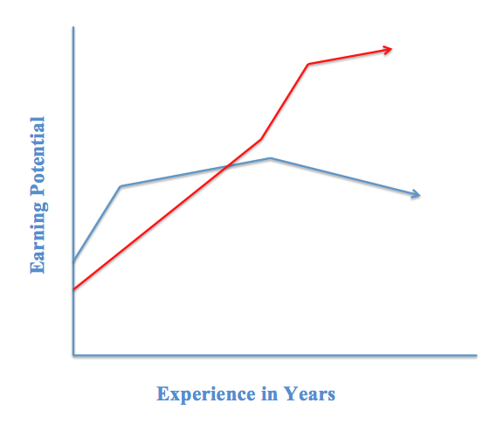
The End is in the beginning! Probabilistic vs. Determinist
My experience with ‘Experience’. Marginal Increases!
Individual Contribution(college)/Group contribution(you)
From tasks based to comprehensive results based
Decision Making in Probabilistic/Determinist Environment (quant vs. emotional, skills needed)

Slide 3
Action Items
Engineers See Only a Small Slice of Firms. Seek Higher Office
Knowledge Management – Be Ready to Throw Away Knowledge. Contribute to Libraries and github in IT
Seek People Skills/Knowledge of Finance
More importantly……be Likeable, be Generous and be Curious
Take Every Possible Exam…Self-knowledge
Create a Digital Footprint to Leave a Professional Trail!
Prepare for a non-linear career path. Learn to manage manager.
Finally….
Put your career plan in writing and update it often!

Slide 4
Organizational Changes in IT
gEnd User/ Customer (Internal and External)
Team of Analysts/Developers
DB/SYS Admin
Team of Analysts/Developers

Slide 5
Organizational Changes in IT
gEnd User/ Customer (Internal and External)
Business Analysts
Team of Analysts/Developers
DB/SYS Admin
Team of Analysts/Developers

Slide 6
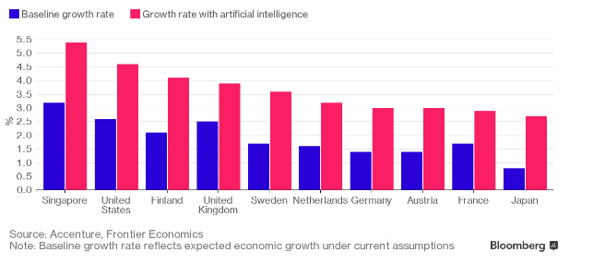
Automation/AI is good

Slide 7
Your accomplishment in perspective

Slide 8
IT changed everything and everything in IT changed!
From automation and programming to…
High Productivity, Minimal DB/Admin, Hardware a substitute for Software
Data – 2.5 Quintillion bytes/day
New Business Models
IT Org. Pyramid. Middle managers add no value.

