Slide 1
IT for New Ventures No case studies! Ask me why!
IIM-R
eMDP 2018
Ram Subramaniam
ramsubra@alumni.gsb.stanford.edu
www.ramsubra.com

Slide 2
Introduction
Why Me?
Short Resume
Questions I have been stumped by!
Real Stories!
Why Now?
Data is raw material of sorts
The impossible is possible now!
Lower Cost
Why in India?
IT – It’s everywhere!
Automation of Automation! Scary even to me!

Slide 3
Links I Forwarded
Wayfair – What’s the problem?
https://www.cnbc.com/2018/11/01/wayfair-spent-196-to-win-over-new-customers-added-over-the-past-year.htmlCasper
Walmart – New Tech Sam’s club
https://techcrunch.com/2018/10/28/walmarts-test-store-for-new-technology-sams-club-now-opens-next-week-in-dallas/
Amazon GO
https://www.cnn.com/2018/10/03/tech/amazon-go/index.html

Slide 4
Strategy and IT
Value Capture Vs. Value Creation
AirBnB,
Casper
Strategic Excellence Vs. Operational Excellence

Slide 5
Industry Level Questions to Ask!
How would the sector change in the future (Tech Vs. Non-Tech)?
Answers
Porter’s 5 Forces
CAGR
VCA

Slide 6
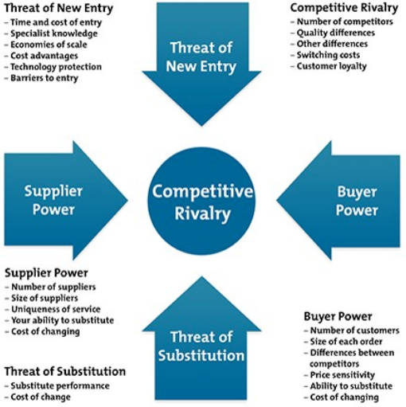
Porter’s 5 Forces

Slide 7
VRIN Competitive Power Test and IT
Valuable – Value for Money
Rare – Your Capability must be rare
Inimitable – Copycats!
Non-Substitutable - Alternatives

Slide 8
Role of IT in Startups Questions
Do you know your CA? Is IT one?
Is your CA sustainable? How?
Can You Adapt?

Slide 9
Choice Example - Cost Vs. Quality* (* Saloner, Shepard, and Podolny – Stanford University)
Low Cost
A
B
High Quality
D
C

Slide 10
IT for New Ventures Second Session Pharma4Ma
IIM-R
eMDP 2018
Ram Subramaniam
ramsubra@alumni.gsb.stanford.edu

Slide 11
Pharma4Ma
Ignore Viability for a moment
Does IT have a role?
Is it Strategic or Operational?
Is IT a CA for PharmaForMa?
What are the Internal Drivers?
What are the External Drivers?

Slide 12
IT roadmap for Pharma4Ma
Software
Hardware
Human Resource
Hire/Outsource
How much should founders know?
Security

Slide 13
PharmaForMa
How would this work without IT?
IT and Marketing Strategy
IT and CAC
IT for internal – Very crucial (Discuss latest meeting)

Slide 14
Conclusion
IT is not optional anymore
Globalization – You will be compared to global standards
No Excuses!
You will be judged by your IT skills
My Best Wishes to you and your venture. Email me with questions.

