Slide 1
CEO-2030 Goals
To comprehend what the position/task would entail in 2030, not next year!
To build a personality for the position and develop a career plan and a back up plan
To sense oncoming mergers/acquisition/hostile takeovers and make career moves accordingly
To acquire power and keep it
To learn to anticipate business models of next decade and lead in an era of AI
To prepare to lead in the globalized economy as an Indian

Slide 2
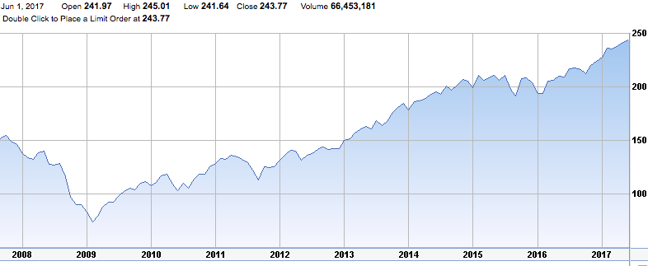
The Genesis of CEO-2030
The Stock Market crash of 2009

Slide 3
The bad news….and the good
The bad news….
¹Indians are exceptionally bright. But don’t communicate
Only 2% of Fortune 500 CEOs are Asians
Perceived as not having ‘executive presence’
Just world belief is just a belief!
The body language speaks loudly!
The value of your academic degree vanes
Only 2 dozen or so women CEOs
The good news…
Demand for Indian IT talent in 80s
We will see big demand in 10 years for Indian CEOs
Adaptation to change (Math focus/Trained to change fast)

Slide 4
Let’s introspect!
Where do you get your identity, self-esteem, and motivation from?
Why do you want to be a CEO? Is the position an end or means to an end?
What can you learn from CEO JD?
Would you be the CEO of a ‘sin’ firm?
Would you fire large number of employees?
Name a CEO you admire! Role models will help!

Slide 5
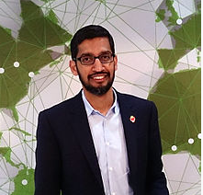
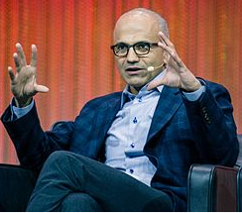
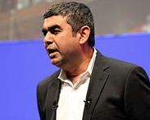
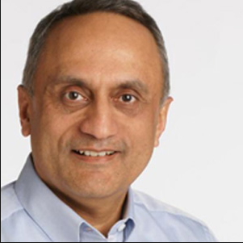
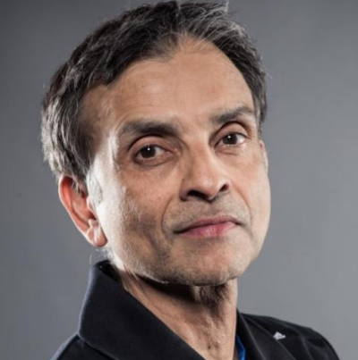
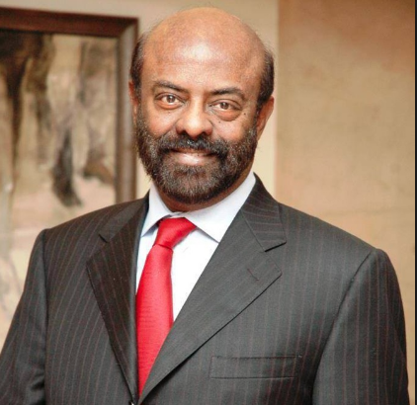
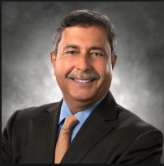
Who is a CEO
Media says…
Pitchai Nadella Sikka
Who are these guys anyway?
Bhargava Ranadive Nadar Mehrotra

Slide 6
Typology
Turn-around
Operations Expert
Strategy Expert
B2B/B2C
Cost Cutter
SME
Public/Private

Slide 7
Pre-requisites
No on the job training. Must have been doing the job/showing traits already without the title.
Thinks like a CEO……not like a VP
Create a persona for investors, board, customers, suppliers. No surprises. Signaling is crucial.
Fearless, never visibly overwhelmed or shocked or driven by impulse!
Likeability/Media darling
M & A/Spin off friendly seeking (Ex: Intel Mcafee)
Industry contacts/CEO advisors
Be obsessed with Data!

Slide 8
The actual and perceived leadership!
Leadership BS¹
Leaders are often immodest and Narcissistic
Leaders are inauthentic
Leaders don’t tell the truth…….always
Leaders are not humble……always
Leaders take care of themselves first
Immoderation is a positive trait

Slide 9
Let’s talk Narcissism¹
Narcissism is increasing and measurable
Productive Narcissists! Anyone you know?
Narcissists have all 4 vital traits of Leaders
Drawback for Asians including Indians
Narcissists take more risks
Narcissism and Confirmation Bias
Not all self-interest is bad

Slide 10
Things to do and not
Be careful. ‘Fatal Euphoria’ is real!
Focus on networking - CEOs bring their own teams
Don’t be a master of all trades. That’s not in JD
Be compassionate whenever possible - dividend/stock
Balance your loyalty to employees and investors
Be ready and open to change your persona
Have someone outside the company to talk to
PE like thinking…and sometimes not
Don’t do anything illegal

Slide 11
As an Indian……
Things are stacked against you.
Brown Penalty!
Don’t seek a linear path to CEO office
Positive stereotyping. Take advantage!
Negative stereotyping - Tackle it. Don’t be silent!
Take pride in our UNIQUE culture.
Use your congenital advantages

Slide 12
My Sincere Thanks!
Does anybody know her?

Slide 13
Our Sincere Thanks to you Sir!
Hemant Karkare (1954 – 2008)

