Slide 1
CEO-2030
Ram Subramaniam
www.ramsubra.com
ramsubra@alumni.gsb.stanford.edu

Slide 2
CEO-2030 Goals
To comprehend what the position/task would entail in 2030, not next year!
To build a personality for the position and develop a career plan and a back up plan
To sense oncoming mergers/acquisition/hostile takeovers and make career moves accordingly
To acquire power and keep it
To learn to anticipate business models of next decade and lead in an era of AI
To prepare to lead in the globalized economy as a person of color

Slide 3
Session No. 1
Who has CEO aspirations?
Why do you want to be a CEO?
Have you read any CEO JD?
Name a CEO you admire! Role models will help!
Would you be the CEO of a ‘sin’ firm?
Aspects Covered in this speech!

Slide 4
The Genesis and History
My General/Stanford Observations of Indian students
Exceptionally bright….but don’t communicate
Not too many have a long term career plan
Don’t fill in the gaps. Expect companies to train them
Not many mentors
Salary Decides their first job
Demand for Indian origin CEOs to pick up
Demand for Indian IT talent in 80s
We will see big demand in 10 years
Adaptation to change (Math focus/Trained to change fast)

Slide 5
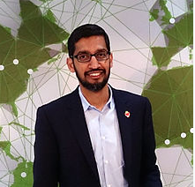
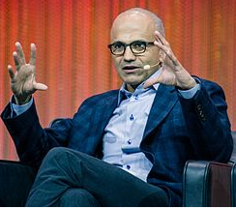
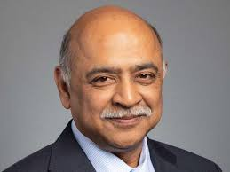
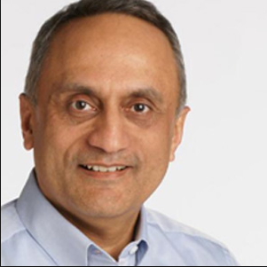
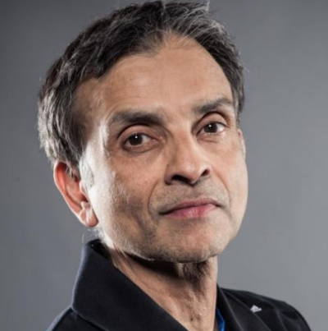
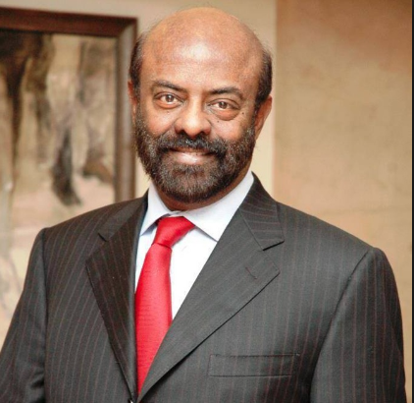
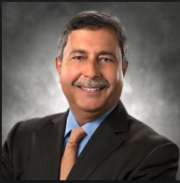
Who is a CEO
Media says…
Pitchai Nadella Krishna
Who are these guys anyway?
Bhargava Ranadive Nadar Mehrotra

Slide 6
The 4 behaviors – The CEO Next Door
Decide – Speed over Precision
Engage for Impact
Reliability
Adapt Boldly

Slide 7
Required and Preferred – The CEO next door
Industry experience
P&L Leadership
Strong People Leadership
Proven Success
Breadth of Experience
Strategic Vision
Operational and financial Acumen
Ability to work with board and external stakeholders
International experience when relevant

Slide 8
Typology
Turn-around
Operations Expert
Strategy Expert
B2B/B2C
Cost Cutter
SME
Public/Private

Slide 9
Future will happen faster!
Rate of creation/destruction of Business Models – Competition of ideas
‘Amazonization’ Deflation/Cost cut/wage cut
Unintended consequences (Ex: AirBnB)
Improved asset utilization factor
Customers value experiences than things!
Must adopt newer tech even if it cannibalizes
Technology will impact inflation substantially
CEO tenures will be shorter! But why?

Slide 10
Pre-requisites
No on the job training. Must have been doing the job/showing traits already without the title.
Thinks like a CEO……not like a VP
Create a persona for investors, board, customers, suppliers. No surprises.
Fearless….never visibly overwhelmed or shocked or driven by impulse!
Likeability/Media darling
M & A/Spin off friendly seeking (Intel Mcafee)
OPI friendly (OPI…not IPO)
Industry contacts/CEO advisors
Obsessed with Data!
Understands PE well

Slide 11
Let’s talk Narcissism
Narcissism is increasing and measurable
Productive Narcissists! Anyone you know?
Narcissists have all 4 vital traits of Leaders
Drawback for Asians including Indians
Narcissists take more risks
Narcissism and Confirmation Bias

Slide 12
CEO-2030 Session No. 2
Congratulations! You are the CEO.

Slide 13
Day 1
Does your appointment signal a change in strategy?
The quality and Clarity of your vision
The courage of your conviction
The ability to articulate both
A pivotal moment!

Slide 14
Three Types of Value Adds
Financial Engineering
Operations Engineering
Governance Engineering

Slide 15
Financial Engineering
Valuation
Excess Cash (Dividend/R&D/Stock Buyback…)
Debt
Earnings Stripping/Transfer Pricing
Pricing Policy
PE defense

Slide 16
Operations Engineering
Suppliers/Single source
Distributors
ML/AI
Hedging
Interline partners

Slide 17
Governance Engineering
Change Directors. But Why?
Interlocking Directors
Reward Influencers. CSR?
Personal Agenda. Lobby for friendly directors!

Slide 18
As an Indian……
Things are stacked against you.
Brown Penalty!
Don’t seek a linear path to CEO office
Positive stereotyping. Take advantage!
Negative stereotyping. Fight it. Don’t be silent!
Leaders are UNIQUE. Don’t aspire to be someone else. Respect your UNIQUE culture above all!
Back to where we started
Why do you want to be a CEO?

Slide 19
My Sincere Thanks!
Does anybody know her?

Slide 20
My Sincere Thanks!
Hemant Karkare (1954 – 2008)

