Slide 1
New Venture Growth Strategies No case studies! Ask me why!
IIM-R
eMDP 2018
Ram Subramaniam

Slide 2
Strategy
The Usage of the word!
Strange Strategy Stories! Religion?
Why did Amazon do it?
So, What is Strategy?
Means to an End/Choices (Ex: Last Slide)
Unique or Best?
For the Present and Future
Say No. Don’t Hesitate!
Scenario Thinking

Slide 3
More Strategy
Two Strategy Types
Business Strategy
Corporate Strategy
This strategy class – What is special?
Value Capture Vs. Value Creation
AirBnB, Casper
Incentive Alignment
Strategy Vs. Operational Excellence

Slide 4
Typology and Strategy
Necessity Vs. Opportunity
Tech Vs. non-Tech
Innovation Vs. Imitation
Funded Vs. non-Funded
This strategy class – What is special?

Slide 5
Industry Level Questions to Ask!
Is this sector attractive now?
How would it change in the future (Tech Vs. Non-Tech)?
Answers
Porter’s 5 Forces
CAGR
VCA

Slide 6
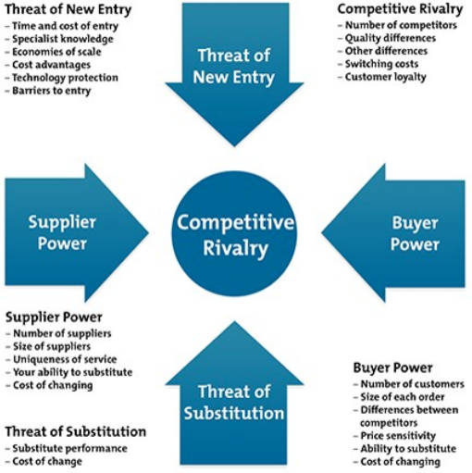
Porter’s 5 Forces

Slide 7
Business Level Questions to Ask!
Where to Position in Market?
What are Venture’s Distinguishing Talents?
Answers
Cost/Value/Price – Market Position
Fill in the Blanks – Strategic Alliances
VRIN

Slide 8
VRIN Competitive Power Test
Valuable – Value for Money
Rare – Your Capability must be Rare
Inimitable – Copycats!
Non-Substitutable - Alternatives

Slide 9
Strategy Delineated!
Go-To-Market
Funding
Marketing/Digital Marketing
Pricing
Exit

Slide 10
Questions for Startups
Do you know your CA?
Value Creation or Value Capture?
Is your CA sustainable?
Can You Adapt?

Slide 11
Choice Example - Cost Vs. Quality* (* Saloner, Shepard, and Podolny – Stanford University)
Low Cost
A
B
High Quality
D
C

